Slide 1
Lacy’s Kiosk
Group Members:
Alisha Locust
Souleymane Y. Mehinhoua
Tim Oliver

Slide 2
Roles and Responsibilities
Role | Name | Organization/ Position | Contact Information
Team member | Tim Oliver | Manager | toliver5557@student.gwinnetttech.edu
Team member | Alisha Locust | Programmer | alocust1660@student.gwinnetttech.edu a.locust@gmail.com
Team member | Souleymane Y. Mehinhoua | Programmer | Smehinh0441@student.gwinnetttech.edu

Slide 3
Mission Statement
Project Title: LACY’S INFORMATION SYSTEM
Project Start Date: January 28
Projected Finish Date: April 25
Budget Information: The budget for this project will be in working hours. Our estimate is 7 hours a week for about 13 weeks. That will total 91 hours of work.

Slide 4
Mission Statement
Project Objectives: Create fully functional desktop software that will allow Lacy to promote their products, sell online, and get feedback from customers. The software should be able to display information about Lacy’s new products, bring attention to existing inventory specials, and create product groups. Customers should be able to shop online, and choose a delivery options, and give feedback on the products. Lacy should also be able to collect information from the system users to assist in the marketing efforts, and respond to prospective customers and partners.

Slide 5
Mission Statement (continued)
Main Project Success Criteria: The project will create a fully functional kiosk program that will be completed on time with a good group experience and everyone having learned how to manage a project well.

Slide 6
Project Plan
Project Justification:
Jay Brown, Instructor for CIST2931 has hired us out to Lacy’s, a retailer business similar to Macy’s. In order to improve their business, Lacy’s want to build a software that will allow the company to promote their products, sell online, and get feedback from the customers. The software should also be able to collect some information about the users.

Slide 7
Project Plan (continued)
Product Characteristics and Requirements:
Database: The application will have a database that will contain product information, customers information, and orders information.
Product groups: The application will group together some fast-moving products with slow moving products to improve sales of slower products.
Product reviews: Customers will be able to leave feedback and reviews for the products they purchase.

Slide 8
Project Plan (continued)
Contact section: This application will allow people to be able to contact the company about various requests, and the company will be able to respond.
Shopping cart: The application will provide a feature to allow customers to place objects into their ‘cart’ and then purchase those items.
The application will collect and store limited information from users for marketing purposes.
User-friendly user interface that groups content into easily navigable areas and sections.

Slide 9
Functional Specifications
GUI Functional Requirements
The System shall implement a Java Swing based GUI.
The GUI will have a page navigation system.
The GUI will Display the User’s user-name at the top of the page once he/she is logged in.
Prior to successful Log-in a User-name and Password text area will be displayed at the top of the page.
A login button will be next to the username and password.

Slide 10
Functional Specifications (continued)
GUI Functional Requirements (Continued)
The Login button will access the database and validate The login based on Username and password.
The GUI will have a main page, Pages correlating to each product category, and a transaction page.
Database Functional Requirements
The database will contain User Profile Information (Username, Password, UserID#, ...)
The database will contain Product information (category, characteristics, price, productId#, ...)
The database will contain Order Information
The database will be compatible with the program and will be accessed

Slide 11
Functional Specifications (continued)
User Functional Requirements
The user will be able to navigate the website and place order as a guest (without logging in)
If he/she have created an account, a user may be asked to log in to his/her account in order to place an order
The user’s Profile will keep track of his/her User-name, Password, and ID#
The User’s Profile will keep track of his/her previous purchases.
The user will only be able to view his/her Profile information(Password, balance, previous purchases, previous orders) if he/she is logged in.

Slide 12
Functional Specifications (continued)
Product Functional Requirements
The User’s profile will keep track of his/her product & site Feedback.
The user will only be able to view his/her Profile information(Password, balance, previous purchases, previous orders) if he/she is logged in.
Products will be listed under the following categories(Home, kitchen, cloths, …)
Products will be displayed on the Category page correlating to their category
Products will have a popularity rating.
Products will be ordered by Popularity on their category page.
Products popularity will be calculated based on sales in a time period

Slide 13
Functional Specifications
Feedback Functional Requirements
Feedback will be stored based on the product the feedback refers to.
Feedback will also be stored for the Business as a whole.
Feedback will have unique Feedback #
Feedback will keep track of The subject of the feedback (Product ID/Business)
Feedback will keep track of the Author of the feedback.
Admins will be able to respond to customer requests

Slide 14
Functional Specifications (continued)
Employee/Administrator Functional Requirements
Employees/Administrator’s Will be able to log on using an Admin Account.
The Admin account will not be able to purchase products.
The Admin account will access an Alternate GUI which grants privileges.
The Admin will be able to Raise or Lower the Price of a product.
The Admin will be able to Add new products to the Database (Using the site GUI?)
The Admin will be able to Remove products from the Database (Using the site GUI?)
The Admin will be able to ship order items.

Slide 15
Functional Specifications (continued)
Program Functional Requirements
The Program will be able to detect when a Product is faster selling or slower selling products.
The Program will suggest slower selling products of the same category if a user adds a fast selling product to their cart.

Slide 16
NonFunctional Specifications
Performance Requirements
The software should be able to handle a large amount of users at a time,
The system should be able to respond to a request in milliseconds
Safety Requirements
Diagnostic checks shall be run twice a week to ensure the Kiosks are running properly.
The Kiosk hardware and software shall be installed in 20 locations across the country for consumer testing.
A Hand sanitizer dispenser shall be kept near the Kiosk to improve cleanliness.
Security Requirements
The Admin Account privileges shall only be given to managers.
An Employee must be posted near the kiosk during customer hours.

Slide 17
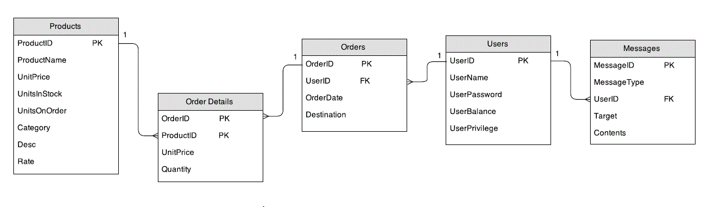
Entity Relationship Diagram
~Text about the Screen flow diagram.

Slide 18
Screen Flow - Layout
Default Main Page
Admin Main Page
Customer Main Page
Customer Product Page
Admin Product Page
Add to Cart (popup)
Check Reviews (popup)
Update Product (popup)
Check Reviews (popup)
My Cart

Slide 19
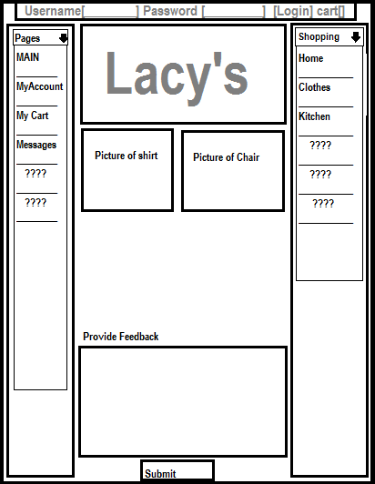
Screen Flow - Main Page
When a user is not signed in, the program reverts to the default user “GUEST”.
From this page the User can *log into his/her account
*Log in as the Admin
*Create a new account
*View product pages [ by category ]
*Check his/her cart
*Write a feedback message about the site
*Check his/her messages
*When the main page is logged in as ADMIN the cart related buttons or inactive.
*When the main page is logged in as a non Admin, or Guest user his/her username is displayed in place of the username box.

Slide 20
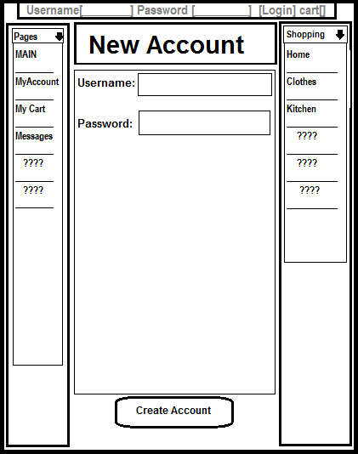
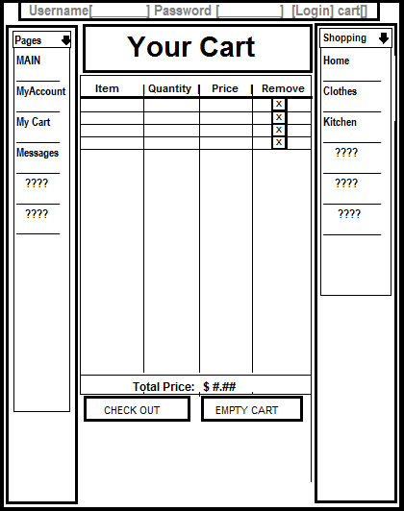
Screen Flow -New Account & My Cart
New Account
My Cart

Slide 21
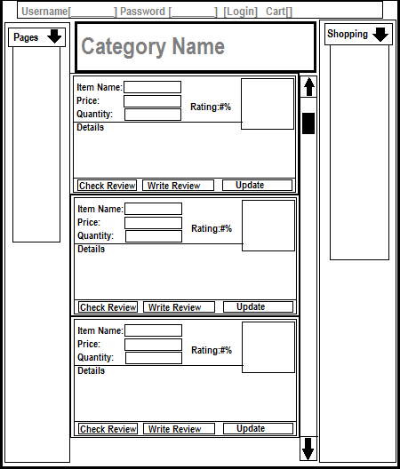
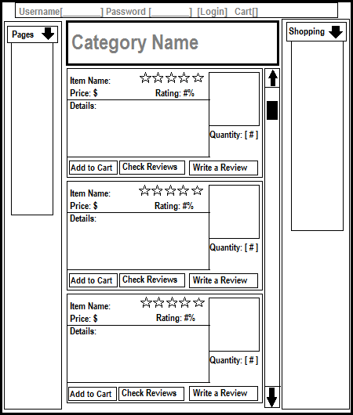
Screen Flow – Product Page
Admin Product Page
Customer Product Page

Slide 22
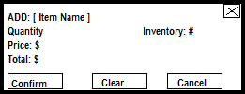
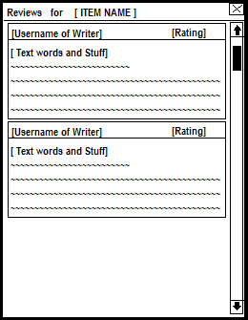
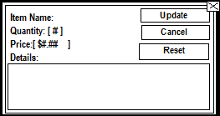
Screen Flow – Pop Ups
Add Item to Cart (customer only)
Check Item Reviews
Update Item
(Admin Only)

Slide 23
Improvements
One future enhancement for the project would be to add a “Wish List” feature that users with accounts could add products to.
Another useful feature could be a time-out feature. Since this is a kiosk application and will be in a physical store, it would be useful to have the program log a user out after a certain amount of time with no activity if a customer is logged in and leaves the kiosk forgetting to log out.
Additionally, if this were an application for a real store, it would be nice to have a way for the customers to track their orders after they are placed.

Slide 24
Challenges
The first challenge related to this group project was to get all the team members actively involved to the success of the project.
The second challenge was the tools to choose for the accomplishment of the project. given that we are working on a desktop application, which programming language to use, which database system? Although we have chosen to use the JAVA programming language, still we had to decide if we are going for a GUI app or a WEB app.

Slide 25
Successes
it has been a success to keep the team members working in a cohesive manner since the beginning of the project.
The other success is that we got a working application with an important number of functionalities.

Slide 26
Take Aways
As a team, we have learned a lot from this group project. By starting the project from the requirements document and working through all the steps of a project management, were able to experiment what is looks like to be working on an actual project in the IT field.
Individually, each of us is aware of how complex it is being working on an actual project with the constraints of time, cost, and quality.

Slide 27
Team Advices
One thing we notice is that we could have use both Java GUI and Java EE Web in the same project.
The web part would be appropriate for the selling stuffs because it makes easier to design the user interface for displaying products, using hyperlinks to go to other pages.
The GUI part would be appropriate to administration part.

